Slide 1
Computer Asset Lifecycle management system (CALMS)
Full Name, Department Name
Photo credit: @bruce.digital

Slide 2
Computer Asset Lifecycle Management System (CALMS)
Is a database used to organize and keep track of assets for the Arts Computing Office. It is important that information is kept up-to-date and is accurate for us to reliably use the information from the database. CALMS tracks an asset from the time it is purchased until it is time to surplus the asset.
Currently in use in ACO and the UW Library

Slide 3
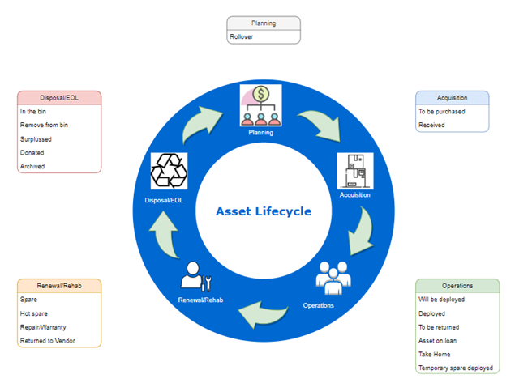
Asset Lifecycle

Slide 4
Development and Production Sites
https://aco-dev.uwaterloo.ca/calms/assets - DEV site for QA and feature test
https://aco-dev.uwaterloo.ca/calms-lib/assets - Library DEV site
https://calms.uwaterloo.ca/assets - ACO production site
https://calms.lib.uwaterloo.ca/assets - Library production site

Slide 5
Asset No
Was initially a 5-digit code and was changed to a 6-digit code in 2021, the first two indicates the year the asset was deployed and the next four is an incremental number which resets to 0 every year. There are assets prior that might have only 4 digits. There have also been cases of older hardware being discovered that have just been recently added to CALMS, so the asset number might not always indicate the age of the asset.

Slide 6
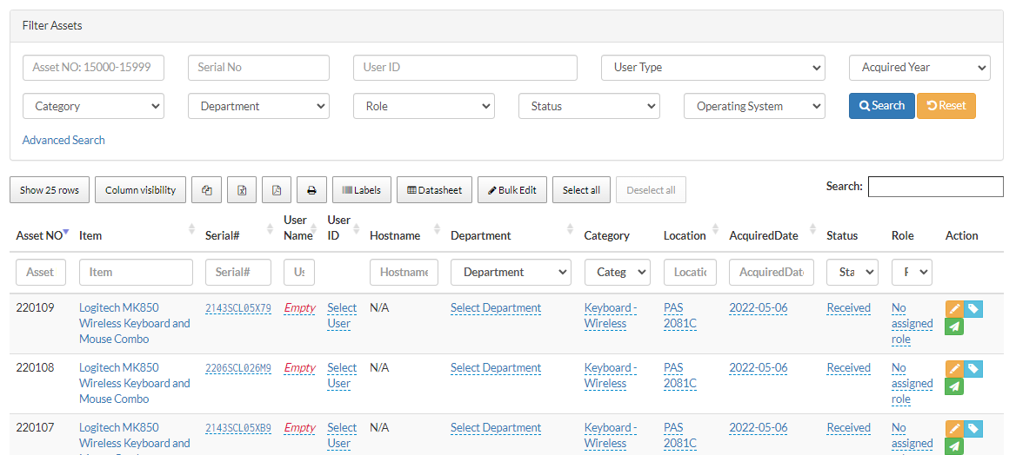
Main Asset View
is the first screen you would see when after you log in. There are numerous filters that you can use to search for assets as well as generate reports or print asset labels. Do not forget to use the Reset button to clear any past filters that were used. Certain columns can also be updated directly from this view.

Slide 7
Search Box
Allows you to quickly search for assets and for user information, you can search for a WatIAM username, hostname, serial number or asset name, MAC address, room location etc.

Slide 8
Dashboard
Provides a basic overview of assets that may require action such as assets that will need their hard drives erased or assets that may be due back to ACO.

Slide 9
Advanced Search Page
Allows you to combine multiple search criteria’s, table results can be exported into various format such as csv, pdf and copied to the clipboard. You can also save your search filter and apply them again, saved searches can be made public so other users can use them.

Slide 10
Adding Assets
Miscellaneous items such as keyboard/mouse, video cards etc. are not tracked in the database however they can be added to a surplus bin without assigning an Asset No.
Assets are mainly created by the Administrative Coordinator during the purchasing process.
Assets can be created individually or added in bulk using the Bulk Add Asset page.
Provide as much accurate information as possible, mainly an asset should have data for the following fields: ACONO, Item, Serial No, Nexus User ID or User, Hostname, MAC Address, Location, Acquired Date, Role, Category, and Status.
Make sure assets have asset labels/tags, printer is located in PAS 2081

Slide 11
Automated Emails
When an asset is scheduled to be erased.
When an asset on-loan is due back to be returned to ACO.
When a staff member has moved from one department to another or has retired, only the primary and secondary support person for the user’s department will receive this email.
When a rollover is assigned to its owner.
Remind deployment owner and client of a scheduled deployment.
Can schedule an email requesting feedback to rollover clients after an asset has been deployed.
It can also send an email to Primary and Secondary departmental support when a previous rollover asset needs to be cleaned-up from DNS or Active Directory.

Slide 12
Rollover Deployments
Deployments are created by staff and assigned to Co-ops.
A deployment will usually be created along with a Request Ticket, keep communication relevant to the deployment on the RT.
Make sure to update the deployment as it goes along the process in CALMS
Once the purchased asset is received, unbox, and label the asset, update necessary information in CALMS (serial number, mac address, memory, CPU etc.)
The Asset Deployment section in CALMS gives the user an overview of all the current rollovers as well as the current stage and status of the asset.
Email templates for prestaging and post deployment
Add Bitlocker/FileVault recovery to CALMS.

Slide 13
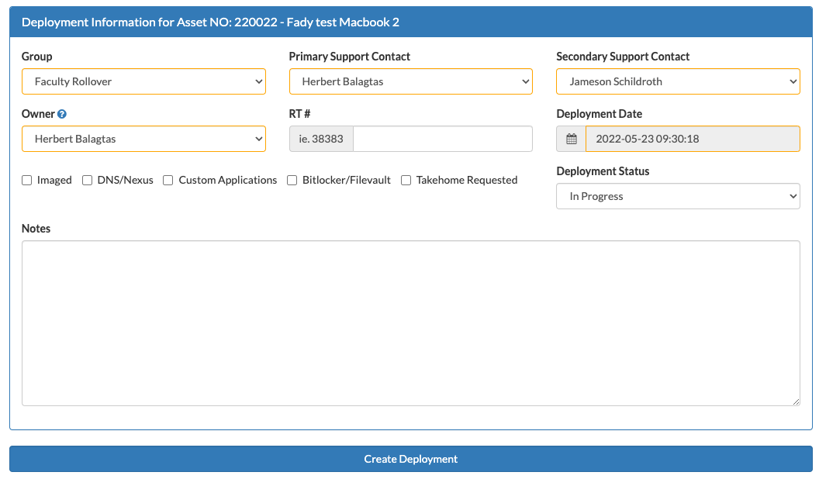

Slide 14
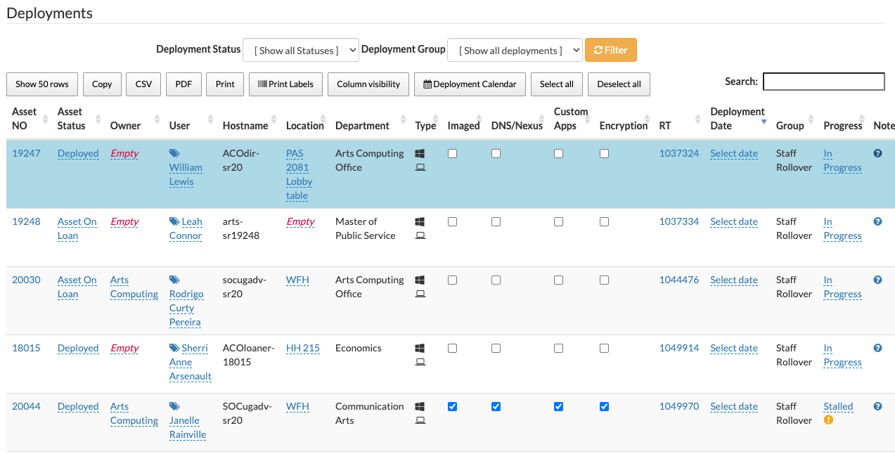

Slide 15
Bitlocker/Filevault Keys

Slide 16
Spare Assets
Keep a decent amount of spare (5-10 per items is a reasonable amount)
From time to time verify that the spare inventory in the room matches what we have on CALMS
Spares can be deployed as well, use the deployment button to initiate the process (staff would usually initiate the deployment)
Loan processes
Make sure to update the status of an asset as they go along the system. Refer to the status list if you are unsure which status should be assigned. https://artsadmin.uwaterloo.ca/calms/statuses

Slide 17
Laptop Loans
https://uwaterloo.atlassian.net/wiki/spaces/ACOHD/pages/43016257597/Laptop+loans
Use the iPad to loan out equipment
Locate the equipment to loan out https://calms.uwaterloo.ca/spares
Use the “Loan Selected Assets” button

Slide 18
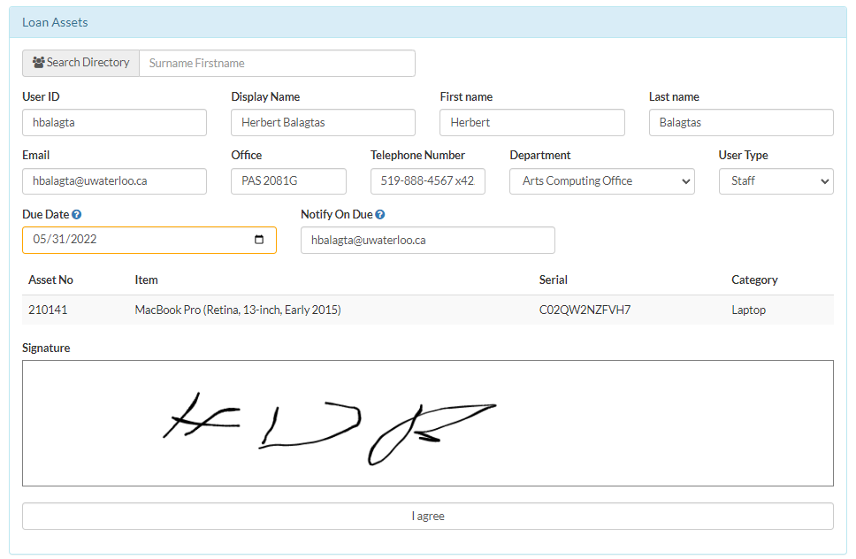

Slide 19
Assets Returned to ACO
Locate the asset in CALMS
Set status to "Returned to ACO"
Update location
The “Scheduled wipe date” should be 30 days from when it was returned
An automated email reminder will be sent to the emails listed in the “Email Notification” field.
After wiping the asset check the “Wiped” checkbox and set the status if it will be used as spare or surplus

Slide 20
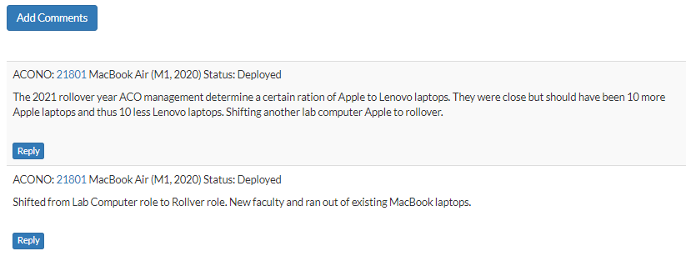
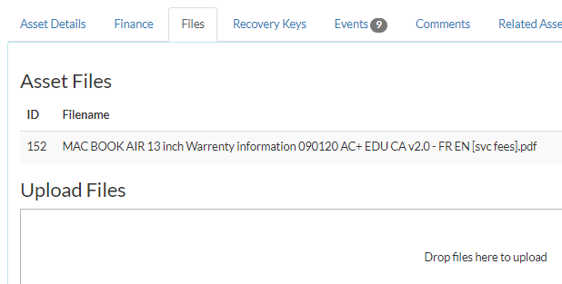
Comments/Files Tab
Each asset has a comment section
Use this section to leave temporary notes about the asset
Comments can be searched using the navbar search box
Use the files tab to attach files/photos relevant to the asset

Slide 21
Surplus Process
On CALMS a bin is created by the Admin Coordinator
Make sure all assets that go in the bin are listed in the surplus section of CALMS
Please make sure to search for the serial number in CALMS if there is no ACONO on the asset
You can add a group of assets which has no ACONO as well to make sure the surplus list is accurate. (ie A box of keyboards, mice, cables)
Once the bin is full, notify the Admin Coordinator so that Central Stores can pick up and provide us an empty bin.

Slide 22
Surplus Process
Click on Surplus Assets
Enter either ACO number, or Serial number for the item, if there is no ACO number it will be assigned as “Unknown”
Enter all information in the fields of the item being surplused
Choose the current bin to enter the item to surplus.
Be very detailed in the Comments section of the item being surplused. Look over previous bins to get an idea of how to complete the information.
Make sure all hard drives are wiped before assets are added into the bin

Slide 23
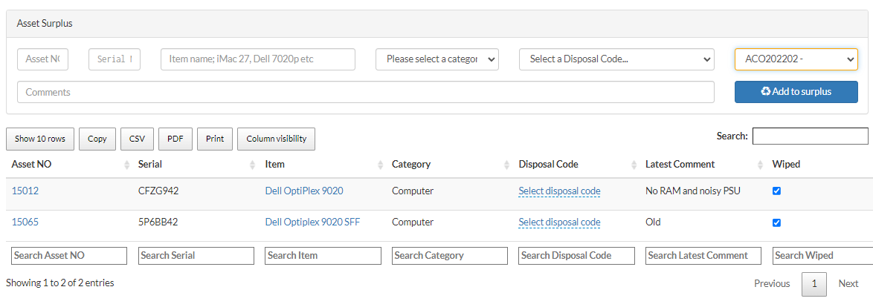

Slide 24
Packing the Bin
Organize the bin as if playing Tetris, heavy items should also be at the bottom, it needs to be packed tightly so nothing moves while the bin is being transported to prevent damage or items falling off the bin.
Do not overpack the bin or packed too high that something will topple out when the bin is moved. Ensure that the heaviest weight of an item is well below the top of the bin sides.
Once the bin is full notify the Admin Coordinator so it can be picked up and a new bin will be left in its place.
The Admin Coordinator will check to see how it is packed and process the paperwork, i.e. generate the report of the items in the bin in CALMS.
The Admin Coordinator prepares the report of the bin items from CALMS and prepare the online surplus request form. Once that is done, no additional items are to be put into the bin. What is in the bin must be on the report so Central Stores can match everything in the bin to the report.
Once the paperwork is completed a print copy will be attached to the bin, no additional items can be put in the bin. Any new items for surplus must be set aside until the new empty bin arrives.
A new bin will be created on CALMS by the Admin Coordinator, assign new surplus items that are set aside to this bin.

Slide 25
CALMS Documentation
https://uwaterloo.atlassian.net/wiki/spaces/ACOHD/pages/2712272900/Computer+Asset+Lifecycle+Management+System+CALMS

