Slide 1
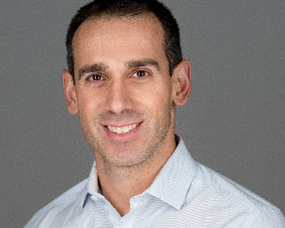
Prostate Cancer Canada Network: Waterloo – Wellington is pleased to announce…
GUEST SPEAKER: DR. DAVID PALMA MD PHD
Presentation Title: Five Steps Toward Getting Top-Notch Cancer Treatment
Let Dr. David Palma, a radiation oncologist and cancer researcher of London Health Science Centre in London Ontario, explain how to take charge of your cancer care.
Dr. Palma is a radiation oncologist and cancer researcher at the London Health Sciences Center and the author of “Taking Charge of Cancer”.
DATE: Thursday October 18, 2018
TIME: 7:00 – 9:00pm
Location:
Grand River Recreation Centre
(Lyle Hallman Pool)
600 Heritage Dr.
Kitchener, ON
N2B 3T9
This FREE presentation is open to all community individuals
RSVP: HopeSpring at 519-742-4673
Answering Service: 226-240-9264
Website: http://pccn-waterloo-wellington.ca
Email: info@pccn-waterloo-wellington.ca

